Slide 1
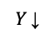
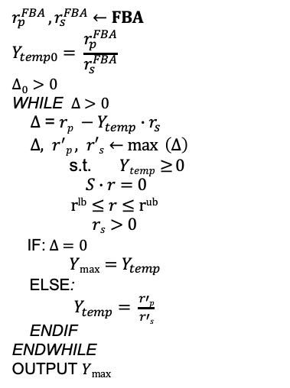
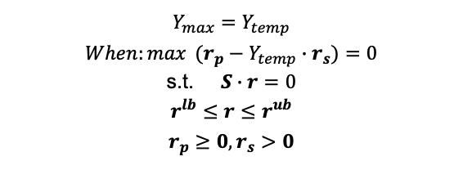
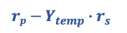
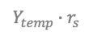
a
$$Y_{max}=Y_{temp}$$
$$When:\max{ (r_{p}−Y_{temp}∙r_{s})=0}$$
$$\text{s}\text{.}\text{t}\text{.} S∙r=0$$
$$r^{lb}≤r≤r^{ub}$$
$$r_{p}≥0,r_{s}>0$$
b
$$r_{p}^{FBA} ,r_{s}^{FBA}←FBA$$
$$Y_{temp0}= \frac{r_{p}^{FBA}}{r_{s}^{FBA}}$$
$$∆_{0} >0$$
WHILE $∆ >0$
$∆$ = $rp −Y_{temp}∙r_{s}$
$∆, r^{′}p , r′s←\max{ \left(∆\right)}$
$$\text{s}\text{.}\text{t}\text{.} Ytemp≥{0}$$
$$S∙r=0$$
$$rlb≤r≤rub$$
$$rs>0$$
$\text{I}\text{F}\text{:} ∆ =0$
$\operatorname{Ymax}{=Y_{temp}}$
ELSE:
$Y_{temp}= \frac{r′p}{r′s}$
ENDIF
ENDWHILE
OUTPUT $Ymax$
c
$$Y \text{↓}$$
Max (Y)
Max (r)
r_{p} (mmol/gDW/h)
$$rp−Y_{temp}∙r_{s}$$
$$Y_{temp}∙r_{s}$$
r_{s} (mmol/gDW/h)

Slide 2
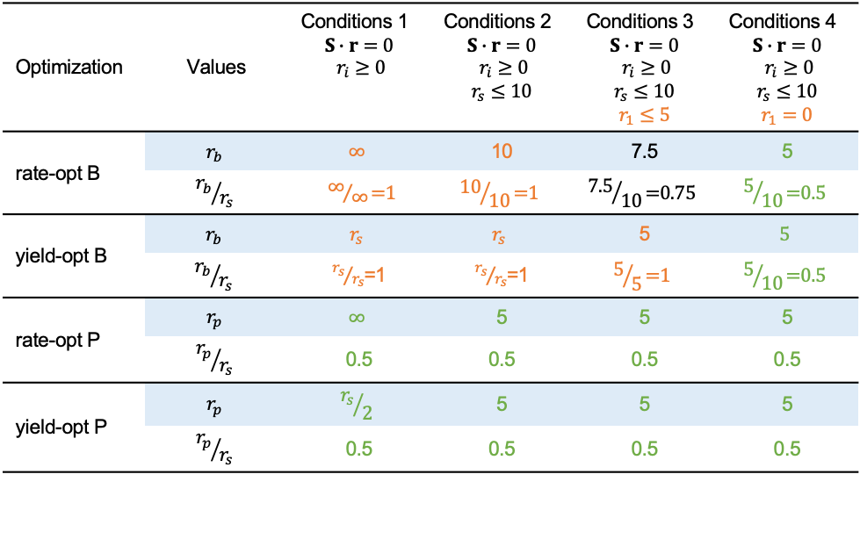
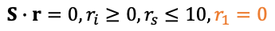
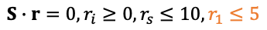
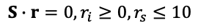
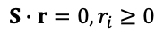
R_{s}
R₁
R_{b}
Internal reactions:
R1: S → B
R2: 2 S → B + P
S
B
Exchange reactions:
Rs: → S
Rb: B →
Rp: P →
P
R₂
R_{p}
Objective:
B
P
Optimal :
rate
yield
Conditions 1:
$$S∙r=0, r_{i}≥0$$
⨉
⨉
Conditions 2:
$$S∙r=0, r_{i}≥0,r_{s}≤10$$
Conditions 3:
$$S∙r=0, r_{i}≥0,r_{s}≤10,r_{1}≤5$$
Conditions 4:
$$S∙r=0, r_{i}≥0,r_{s}≤10,r_{1}=0$$
Optimization | Values | Conditions 1 $$S∙r=0$$ $$r_{i}≥0$$ | Conditions 2 $$S∙r=0$$ $$r_{i}≥0$$ $$r_{s}≤10$$ | Conditions 3 $$S∙r=0$$ $$r_{i}≥0$$ $$r_{s}≤10$$ $$r_{1}≤5$$ | Conditions 4 $$S∙r=0$$ $$r_{i}≥0$$ $$r_{s}≤10$$ $$r_{1}=0$$
rate-opt B | $$r_{b}$$ | $$∞$$ | 10 | 7.5 | 5
 | $${r_{b}}/{r_{s}}$$ | ${\text{∞}}/{\text{∞}}\text{=1}$ | $${\text{10}}/{\text{10}}\text{=1}$$ | $${\text{7.5}}/{\text{10}}\text{=0.75}$$ | $${\text{5}}/{\text{10}}\text{=0.5}$$
yield-opt B | $$r_{b}$$ | $$r_{s}$$ | $$r_{s}$$ | 5 | $$5$$
 | $${r_{b}}/{r_{s}}$$ | ${r_{s}}/{r_{s}}$=1 | ${r_{s}}/{r_{s}}$=1 | $${\text{5}}/{\text{5}}\text{=1}$$ | $${\text{5}}/{\text{10}}\text{=0.5}$$
rate-opt P | $$r_{p}$$ | $$∞$$ | 5 | 5 | 5
 | $${r_{p}}/{r_{s}}$$ | 0.5 | 0.5 | 0.5 | 0.5
yield-opt P | $$r_{p}$$ | $${r_{s}}/2$$ | 5 | 5 | 5
 | $${r_{p}}/{r_{s}}$$ | 0.5 | 0.5 | 0.5 | 0.5

Slide 3
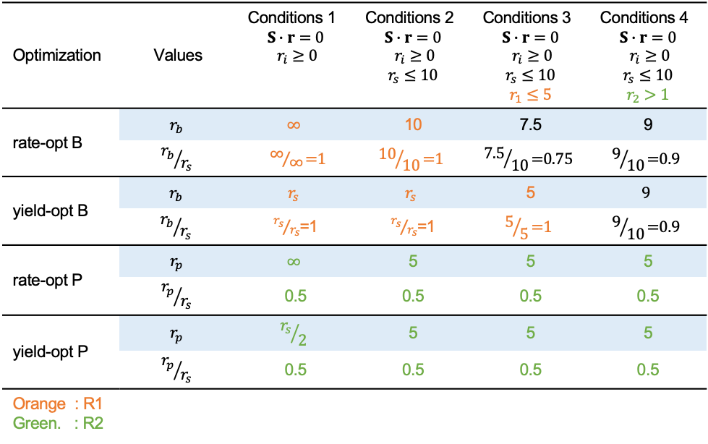
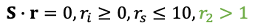
R_{s}
R₁
R_{b}
Internal reactions:
R1: S → B
R2: 2 S → B + P
S
B
Exchange reactions:
Rs: → S
Rb: B →
Rp: P →
P
R₂
R_{p}
Objective:
B
P
Optimal :
rate
yield
Conditions 1:
$$S∙r=0, r_{i}≥0$$
⨉
⨉
Conditions 2:
$$S∙r=0, r_{i}≥0,r_{s}≤10$$
Conditions 3:
$$S∙r=0, r_{i}≥0,r_{s}≤10,r_{1}≤5$$
Conditions 4:
$$S∙r=0, r_{i}≥0,r_{s}≤10,r_{2}>1$$
Optimization | Values | Conditions 1 $$S∙r=0$$ $$r_{i}≥0$$ | Conditions 2 $$S∙r=0$$ $$r_{i}≥0$$ $$r_{s}≤10$$ | Conditions 3 $$S∙r=0$$ $$r_{i}≥0$$ $$r_{s}≤10$$ $$r_{1}≤5$$ | Conditions 4 $$S∙r=0$$ $$r_{i}≥0$$ $$r_{s}≤10$$ $$r_{2}>1$$
rate-opt B | $$r_{b}$$ | $$∞$$ | 10 | 7.5 | 9
 | $${r_{b}}/{r_{s}}$$ | ${\text{∞}}/{\text{∞}}\text{=1}$ | $${\text{10}}/{\text{10}}\text{=1}$$ | $${\text{7.5}}/{\text{10}}\text{=0.75}$$ | $${\text{9}}/{\text{10}}\text{=0.9}$$
yield-opt B | $$r_{b}$$ | $$r_{s}$$ | $$r_{s}$$ | 5 | $$9$$
 | $${r_{b}}/{r_{s}}$$ | ${r_{s}}/{r_{s}}$=1 | ${r_{s}}/{r_{s}}$=1 | $${\text{5}}/{\text{5}}\text{=1}$$ | $${\text{9}}/{\text{10}}\text{=0.9}$$
rate-opt P | $$r_{p}$$ | $$∞$$ | 5 | 5 | 5
 | $${r_{p}}/{r_{s}}$$ | 0.5 | 0.5 | 0.5 | 0.5
yield-opt P | $$r_{p}$$ | $${r_{s}}/2$$ | 5 | 5 | 5
 | $${r_{p}}/{r_{s}}$$ | 0.5 | 0.5 | 0.5 | 0.5
Orange : R1 Green. : R2

Slide 4
B Rate Optimal
a
b
c
P Rate Optimal
a
b
c

Slide 5
a
Biomass rate optimal
c
Acetate rate optimal
b
d

Slide 6
a
Condition 2
b
Condition 3
c
Condition 4
d
e
f

Slide 7
Production envelope
Yield space

Slide 8
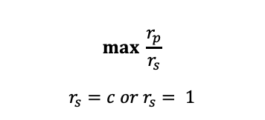
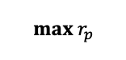
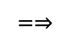
$$max \frac{r_{p}}{r_{s}}$$
$$r_{s}=c or r_{s}= 1$$
$$=⇒$$
$$max{ r}_{p}$$

Slide 10
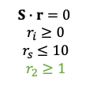
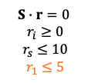
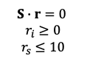
Condition 2
Condition 3
Condition 4
$$S∙r=0$$
$$r_{i}≥0$$
$$r_{s}≤10$$
$$S∙r=0$$
$$r_{i}≥0$$
$$r_{s}≤10$$
$$r_{1}≤5$$
$$S∙r=0$$
$$r_{i}≥0$$
$$r_{s}≤10$$
$$r_{2}≥1$$
1:0
1:0
1:0
1:1
0:1
9:1

Slide 11
Condition 2
Condition 3
Condition 4
$$S∙r=0$$
$$r_{i}≥0$$
$$r_{s}≤10$$
$$S∙r=0$$
$$r_{i}≥0$$
$$r_{s}≤10$$
$$r_{1}≤5$$
$$S∙r=0$$
$$r_{i}≥0$$
$$r_{s}≤10$$
$$r_{2}≥1$$
0:1
0:1
0:1
0:1
0:1
0:1

Slide 12
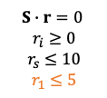
Condition 3
Optimal acetate rate
$$S∙r=0$$
$$r_{i}≥0$$
$$r_{s}≤10$$
$$r_{1}≤5$$
1:0
1:1

